Slide 1

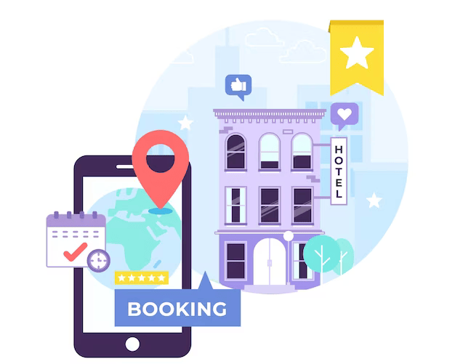





Hotel Booking System
COMP3030 - Group 3
Mon
Tue
Wed
Thu
Fri

Slide 2
Table of contents
01
02
Introduction
Business Requirement
03
04
Data Model
Database Schema

Slide 3
01
IntroDuction

Slide 4
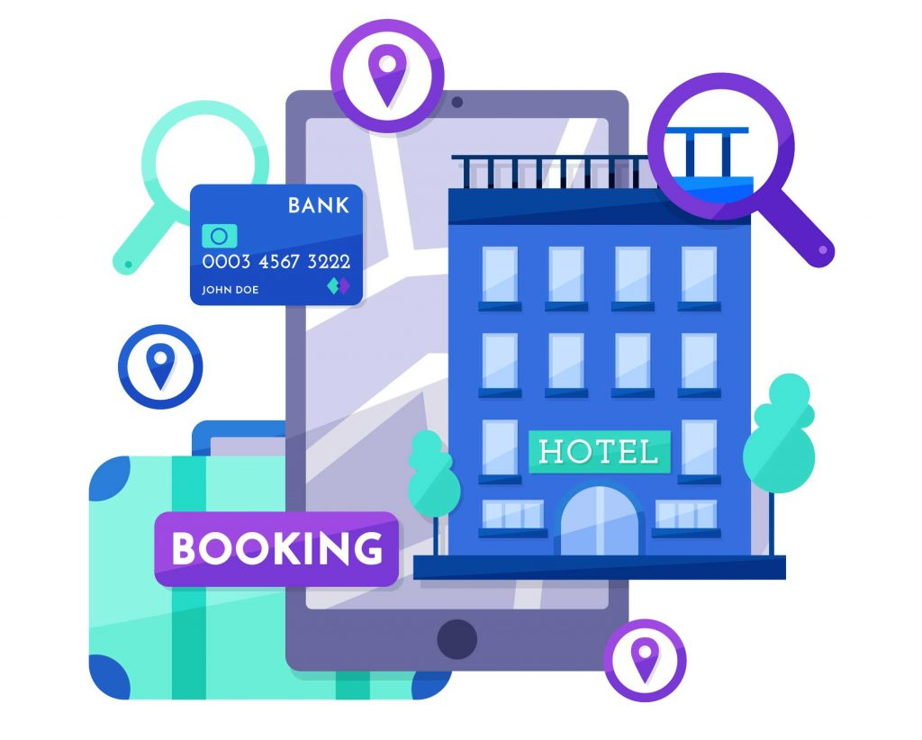
VinKun
Objective
A luxury hotel chain, requires a booking management system to enhance operational efficiency.
Enhance guest satisfaction through a smooth booking experience.
Optimize internal processes for hotel staff, improving productivity.

Slide 5
Key Data
Guest Reservations: Simplified and automated booking process for guests.
Room & Service Booking: Integrated system for easy management of room availability and additional services.
Customer Feedback: Allow customer to give feedback after their stay

Slide 6
02
Business Requirements

Slide 7
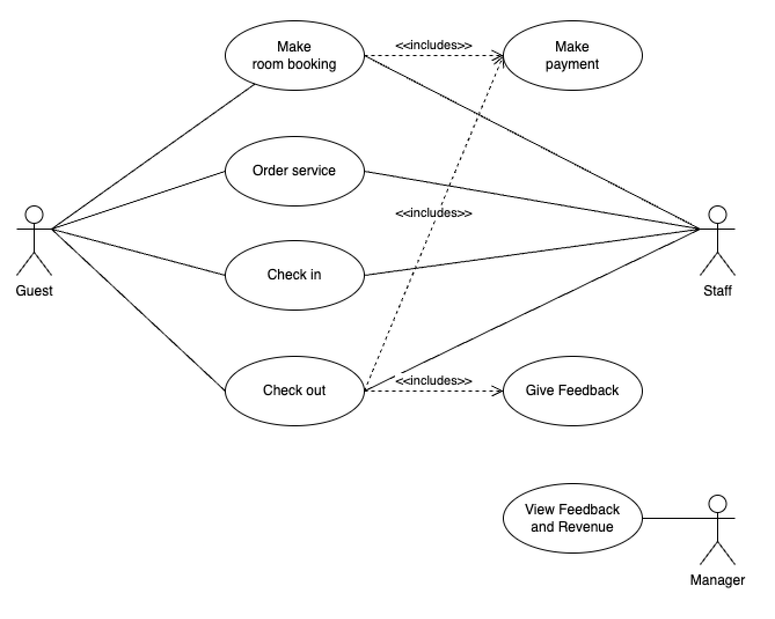
Use Case Diagram

Slide 8
Room Booking
Name of Use Case | Room Booking
Goal | Enables guests to book a hotel room through an online booking system
Actor(s) | Guest
Trigger | Guest decides to book a hotel room.
Entry Conditions | None
Post Conditions | Room is successfully booked, and booking details are sent to the guest

Slide 9
Event | Description
1 | Guests access the hotel booking system
2 | System presents a comprehensive list of hotels.
3 | Guests input their intended stay dates.
4 | System shows available rooms based on selected dates.
5 | Guest selects room type and quantity.
6 | Guest fills out personal details.
7 | System provides a summary of the booking.
8 | Guest selects payment method and completes transaction.
9 | System sends confirmation email with detailed booking information.
10 | Guests can submit service requests using QR code in confirmation email.

Slide 10
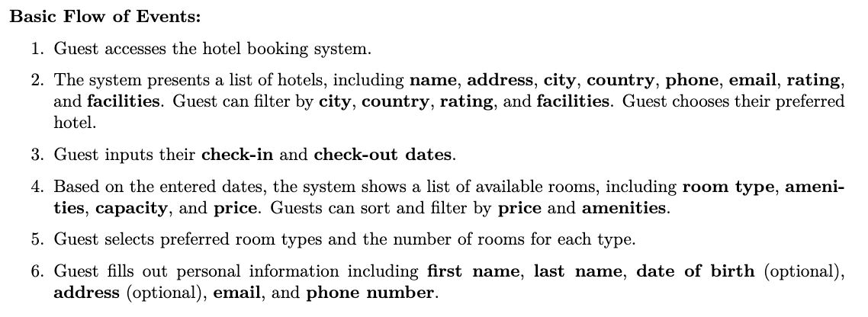
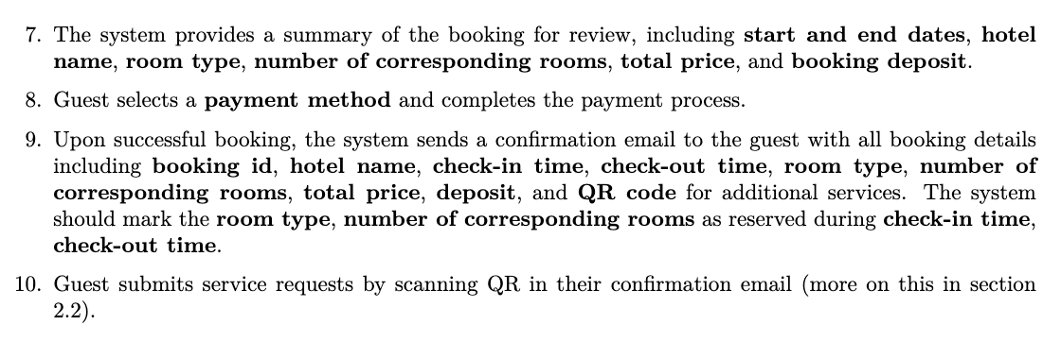
Data Details

Slide 11
Room Booking
Alternate Flows
Exceptions
3. Guest modifies selected dates or hotel choice.
7. Guest returns to modify room choice or personal details before finalizing the booking
6. Incomplete or invalid personal information submitted.
8. The payment process fails or is declined.

Slide 12
Service Ordering
Name of Use Case | Service Ordering
Goal | Enables guests to order services through a digital menu accessible via QR code before and during their stay.
Actor(s) | Guest, Staff
Trigger | Guest decides to order a service using the digital service menu.
Entry Conditions | Guest must have a valid booking id to access the service menu. Guest must be able to scan the QR code sent to their email.
Post Conditions | Service order is successfully placed and confirmed by guest and staff

Slide 13
Service Ordering
Event | Description
1 | Guests use the QR code to access the service menu.
2 | System displays a digital menu with detailed service options.
3 | Guest selects a service and provides specific details.
4 | Automated notification sent to hotel staff.
5 | Hotel staff reviews and confirms the service request.
6 | System confirms the order with the guest.

Slide 14
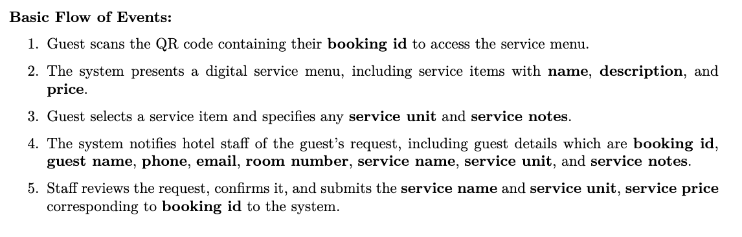

Data Details

Slide 15
Service Ordering
Alternate Flows
Exceptions
5. Staff suggests modifications or alternatives to the service requested based on availability or other constraints
1. QR code does not work or fails to load the service menu

Slide 16
Check-In
Name of Use Case | Guest Check-In and Room(s) Assigning
Goal | Facilitates the process of verifying guest reservation and assigning rooms upon arrival.
Actor(s) | Guest, Staff
Trigger | Guest arrives at the hotel and initiates the check-in process
Entry Conditions | Guest must have a valid reservation. Staff must have access to the hotel management system
Post Conditions | Guest is successfully checked in and assigned room(s)

Slide 17
Check-in
Event | Description
1 | Guests arrive and present identification and reservation confirmation.
2 | Staff verifies guest information in the system.
3 | System shows comprehensive booking details upon verification.
4 | Staff checks for available rooms using the system.
5 | Staff assigns rooms based on guest preferences and availability.

Slide 18
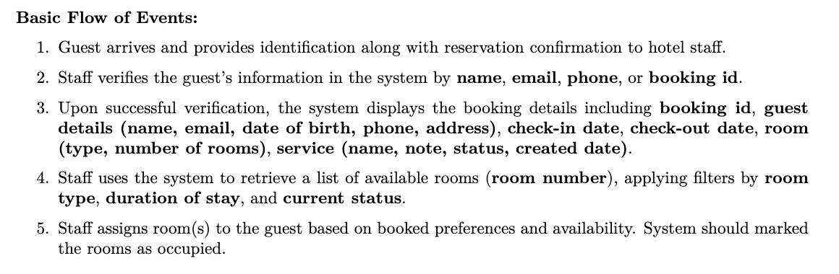
Data Details

Slide 19
Check-Out
Name of Use Case | Guest Check-Out and Payment
Goal | Manages the guest’s departure process, including verification, billing, and payment.
Actor(s) | Guest, Staff
Trigger | Guest approaches the reception to check out
Entry Conditions | Guest must have completed their stay. Staff must have access to the hotel management system.
Post Conditions | Guest has checked out, payment is processed, and the stay is marked as complete

Slide 20
Check-Out
Event | Description
1 | Guest provides identification at check-out for verification.
2 | Staff verifies booking ID and retrieves stay details.
3 | System calculates the final bill.
4 | Guest reviews the final bill and chooses a payment method.
5 | Staff confirms payment and checks room condition.
6 | System sends a thank-you email and feedback form to the guest.

Slide 21
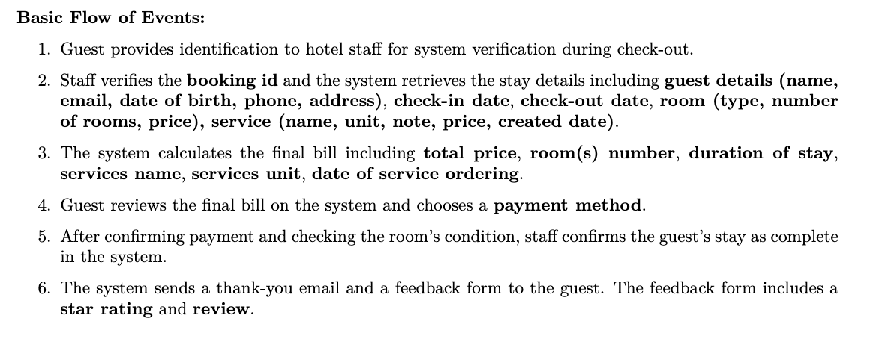
Check-Out

Slide 22
Manager View
Name of Use Case | Manager View
Goal | Enables the hotel manager to review financial reports and customer feedback within a specified time range.
Actor(s) | Manager
Trigger | Manager decides to review hotel revenue and customer feedback
Entry Conditions | Manager must be logged into appropriate website
Post Conditions | Manager has received reports on hotel revenue and customer feedback

Slide 23
Manager View
Event | Description
1 | Manager logs into the management system.
2 | Manager inputs a specific time range for revenue reports.
3 | System calculates and presents revenue details.
4 | Manager specifies a time range for customer feedback.
5 | System retrieves and displays customer feedback.
6 | Manager reviews the data for business insights and decision-making.

Slide 24
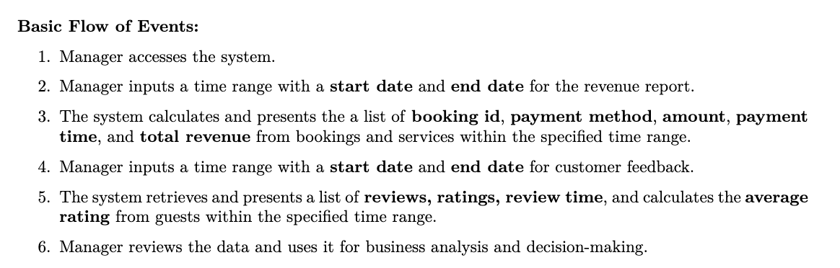
Manager View

Slide 25
03
Data
Model

Slide 26
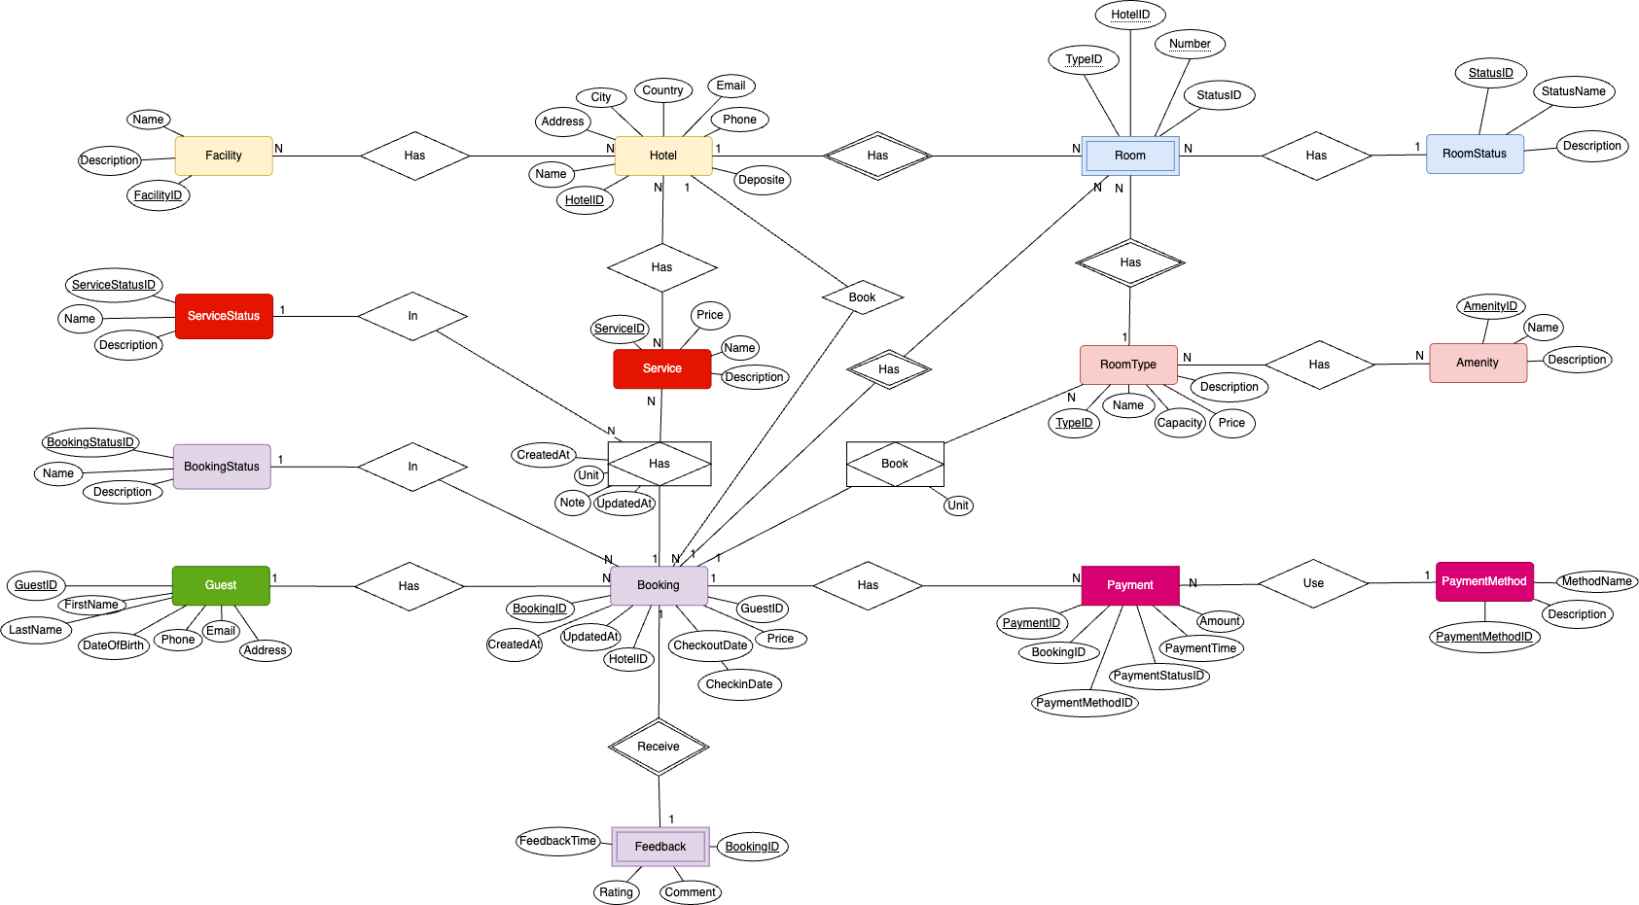
ERD

Slide 27
04
DataBASE
DESIGN

Slide 28
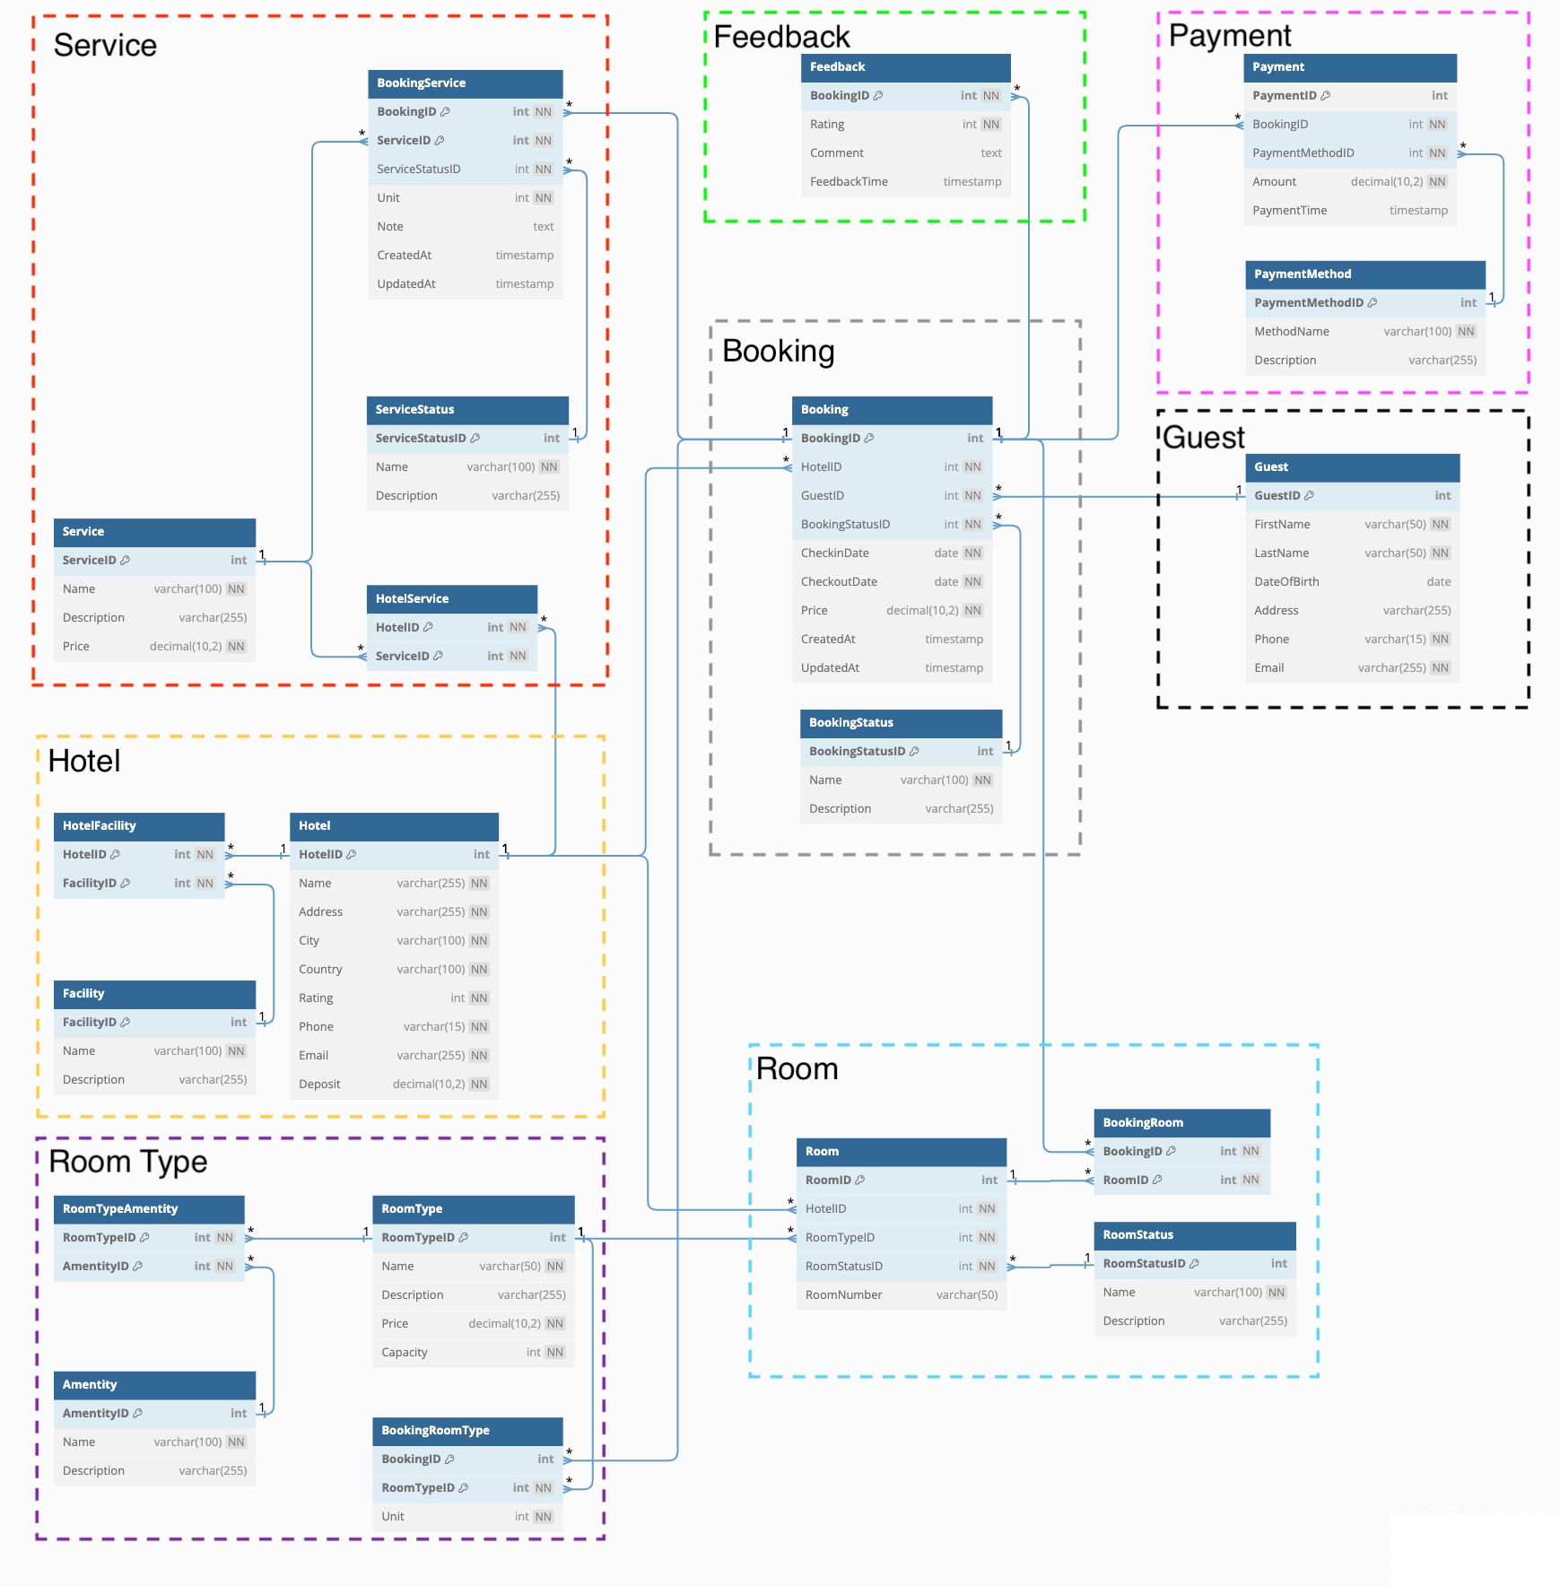
Database Design

Slide 29
THANKS!

